Slide 1
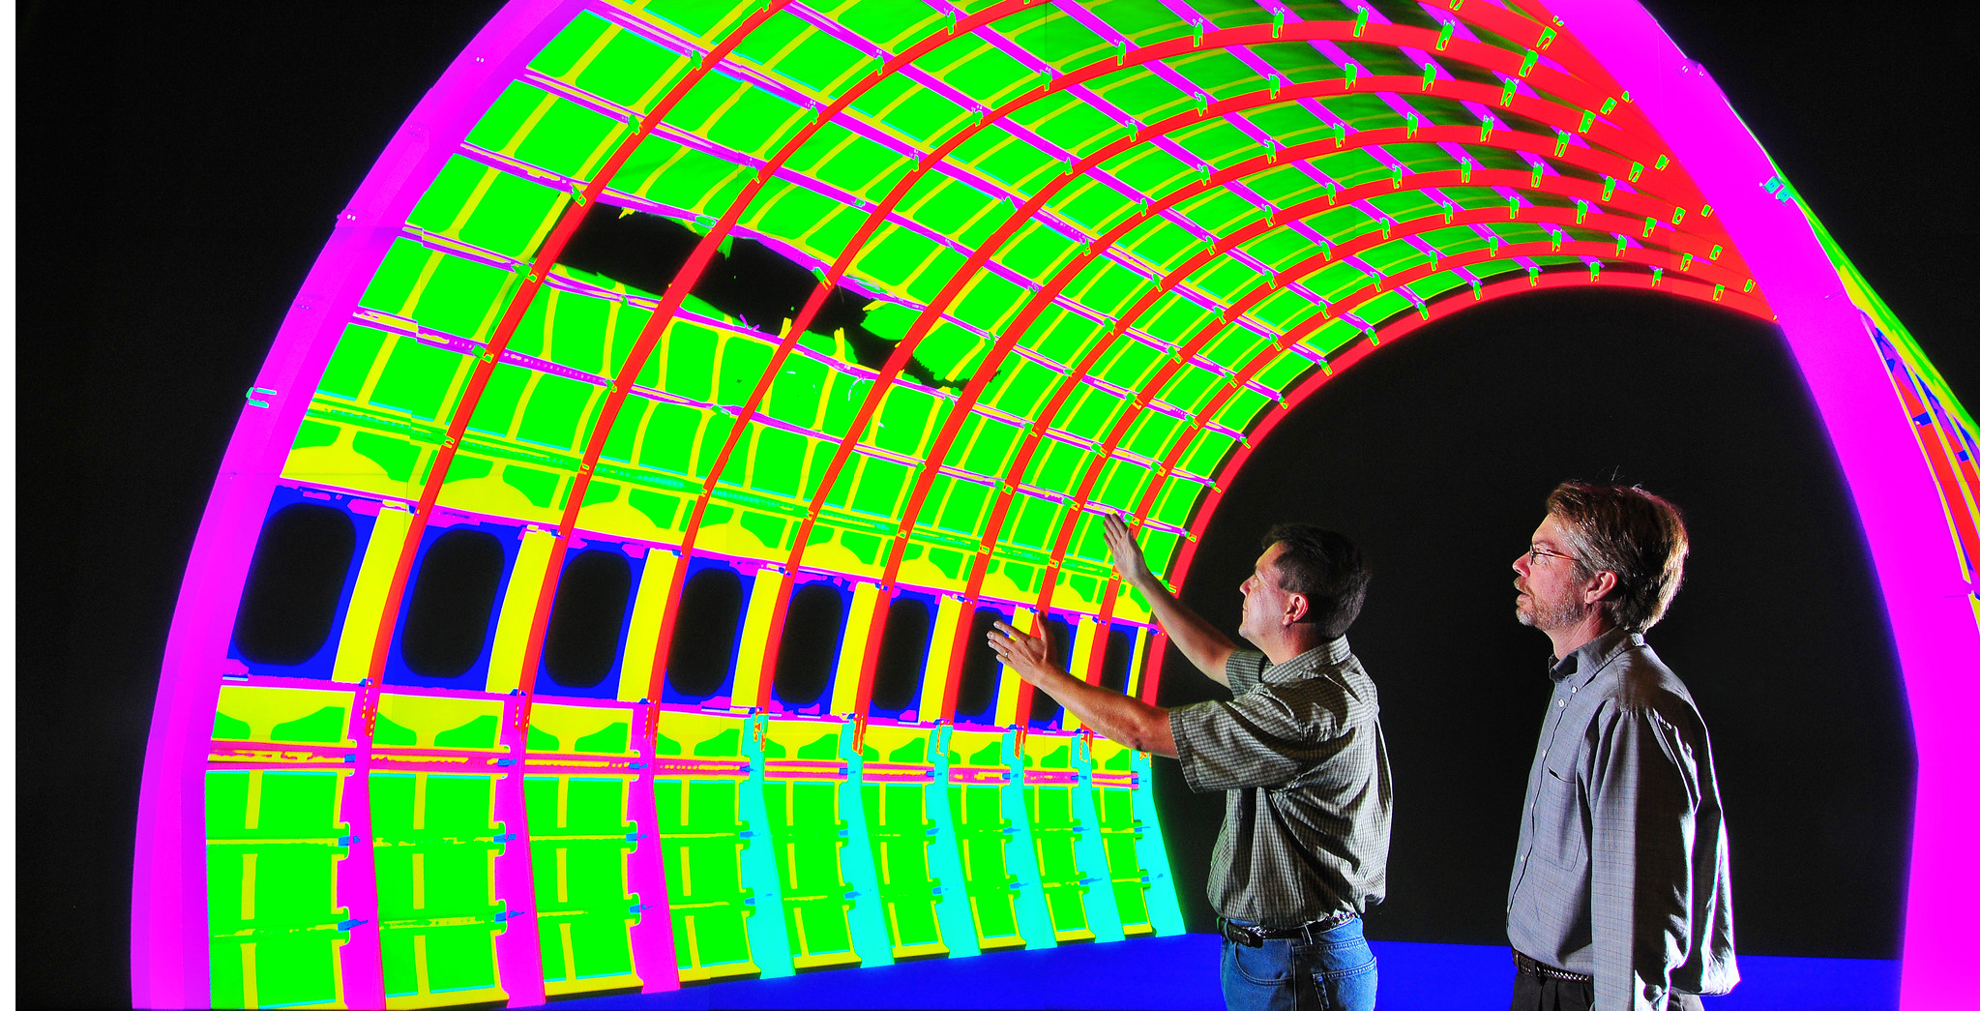

Kokkos Ecosystem State of the Union
Presenting on behalf of the Kokkos team:
Christian Trott + Luc Berger-Vergiat
Sandia National Laboratories, Center for Computing Research
SANDXXXX C

Slide 2
Kokkos Community

Slide 3
Kokkos in a post-ECP World
Community
Universities
Hardware vendors
CEA
ASCR – Stewardship
CASS – S4PST
NNSA – ASC Program
SNL
ASCR – Facilities
OLCF, ALCF, NERSC

Slide 4
Merged PRs Kokkos Core Jan-May
Beginning of ECP
End of ECP
Expecting – and seeing - no reduction in development effort!
Expansion of team to ASCR Labs

Slide 5


Joining the LF High Performance Software Foundation
Kokkos is now a Linux Foundation project in the High Performance Software Foundation!

Slide 6
The High Performance Software Foundation
Launched at ISC in May 2024!
Sponsors:
US Labs: SNL, LLNL, ORNL, LBL, LANL and ANL
Industry: HPE, Amazon (AWS), NVIDIA, AMD, Intel, Kitware
Others: CEA, CSCS,
Scope:
Help sustain critical software technologies for HPC and related areas
What does it do:
Guarantees Open Governances (e.g. github.com/kokkos is owned by LF)
Help organize and pay for meetings and workshops
Help finance and organize project infrastructure (e.g. Slack)
Work with other organizations such as OpenSSF, LFEdge for overlapping concerns

Slide 7







HPSF Structure
Governing Board (GB)
Collaborations
GB Committees
Events & Training
Marketing
Budget & Finance
Technical Advisory Council (TAC)
Working Groups
Technical Projects
CI & Testing
Facility Engagement
Spack
Kokkos
Apptainer
Software Stacks
Safety and Security
Viskores
HPCToolkit
E4S
End Users
Benchmarking
Trilinos

Slide 8
Kokkos: what changes?
For users:
Expect no immediate changes in support or delivery mechanism
Long term: more sustainable product with broader developer base
Don’t name your product KokkosFoo => there are now trademark rules
No issue with referring to Kokkos, saying you are using it, saying your project is based on Kokkos etc.
“Foo for Kokkos”, “Foo power by Kokkos” etc. is fine
For developers:
We have now governance rules when needed
We are actively looking for more institutions to contribute to Kokkos!

Slide 9
Kokkos Core Updates

Slide 10
Ongoing work
>80% routine software development/maintenance
Bugs, changing toolchains, minor improvements such as interface consistency
C++20 transition for Summer 2025
Good idea to start having a build or so for your apps/libraries with C++20
Don’t expect any real issues
Actively working on mdspan transition
Some usability improvements this would allow require C++20
We are shipping C++23 mdspan (as C++17 backport) in Kokkos
Kokkos 4.4 will bring interop interfaces (View ⬄ mdspan):
Kokkos::View<int*> a("A",13);
// construct mdspan from view
Kokkos::mdspan<int, Kokkos::dextents<size_t, 1>> a_mds(a);
// return mdspan from View (this is using layout_right_padded)
auto b_mds = a.to_mdspan();
// construct View from mdspan
Kokkos::View<int*> b(b_mds);

Slide 11
Recent(ish) Kokkos Capabilities
C++ Standard Algorithms (Core)
E.g. Kokkos::transform (exec, a, b, operation);
>60 algorithms
Work on Views or Iterators
Easy on-ramp for any C++ programmer used to standard algorithms
C++ SIMD Types (Core)
Leverage SIMD intrinsics on host
Interface based on ISO C++ 26 proposal
Works seamlessly when compiling for GPUs
Reliably get performance out of CPUs with long vector units

Slide 12
Multi GPU Support - Experimental
Support using multiple GPUs from a single process
Highly Experimental and CUDA only!
But should largely work at this point
For now: interoperability interface only for CUDA
I.e. user has to create execution space instances via backend specific APIs
We are looking for feedback
Two usage modes
Have multiple host threads – each assigned to a specific GPU
Dispatch overlapping work to multiple GPUs from the same host thread
Who this is intended for
Higher level runtime systems such as Legion, Uintah, HPX etc.
Folks who want to use multiple GPUs on a single node without MPI
No reason to use this if you already use MPI !!!

Slide 13
Multi GPU Support CUDA Example
// create CUDA streams on different GPUs
cudaStream_t[2] streams;
cudaSetDevice(0); cudaStreamCreate(&streams[0]));
cudaSetDevice(1); cudaStreamCreate(&streams[1]));
{
// Create Kokkos Execution Space instances from streams
Kokkos::Cuda exec0(streams[0]), exec1[streams[1]);
// Allocate Views on specific devices
Kokkos::View<int *, TEST_EXECSPACE> view(Kokkos::view_alloc("v0", exec0), n);
Kokkos::View<int *, TEST_EXECSPACE> view(Kokkos::view_alloc("v1", exec1), m);
// run kernels concurrently
Kokkos::parallel_for(Kokkos::RangePolicy<Cuda>(exec0, 0, n), functor);
Kokkos::parallel_for(Kokkos::RangePolicy<Cuda>(exec1, 0, m), functor);
// wait for both GPUs to be done with work
exec0.fence(); exec1.fence();
// implicitly release execution space instances
}
// destroy the CUDA streams again
cudaStreamDestroy(streams[0]); cudaStreamDestroy(streams[1]);

Slide 14
Unified Memory Architectures Support (NVIDIA GH and AMD MI300)
What we wanted:
Unified Arch
Non-Unified Arch
Access
Access
DeviceSpace
(Always HBM)
GPU
GPU
SharedSpace
(Migrates)
CPU
CPU
HostSpace
(Always DDR)

Slide 15
What Grace-Hopper Allows
Unified Arch
Access
DeviceSpace
(Always HBM)
GPU
SharedSpace
(Migrates)
CPU
HostSpace
(Always DDR)
CUDA does not have an allocator which guarantees HBM and is host accessible.
Depending on allocator: data may move every time accessed or sporadically
Overallocation will only reduce performance – not fail with “Out of memory”

Slide 16
Unified Memory Path forward
Complained to NVIDIA
We have a PR adding GH support
Fixed internal issues around making default mem-space host accessible
Will have configure option whether default allocation is host accessible
If ON: allocate migratable memory with memadvise to prefer HBM
We could work with HPCToolkit to explicitly detect migration of View data we don’t want to migrate …
We don’t’ expect the same issue with MI300 -> no migration
MI300 unified memory support in develop now:
-DKokkos_ENABLE_IMPL_HIP_UNIFIED_MEMORY=ON (default is OFF)
-DKokkos_ENABLE_IMPL_HIP_EMULATE_UNIFIED_MEMORY=ON => try the behavior on MI250
Expect default ON in the future (4.4 or 4.5)
Benefit: no duplicated memory allocations

Slide 17
Ideas for Future Directions of Kokkos Core
Edge computing / Embedded Support
Many of the same concerns as HPC – resource constraint, performance critical
Many different devices including FPGAs
Programming Language Safety
More concern about cyber security – how do we write safer code?
Kokkos data abstractions (View/mdspan/mdarray) enable safer encapsulation – could make it almost impossible to have out of bounds memory access
Combined with static analysis could be significant step to enable C++ codes which are memory safe by design
More Asynchronous Dependency Based Software design
Incorporate ISO C++ Senders/Receivers interface

Slide 18
Kokkos Kernels Updates

Slide 19
Block TriDiagonal Solver
Kim Liegeois

Slide 20
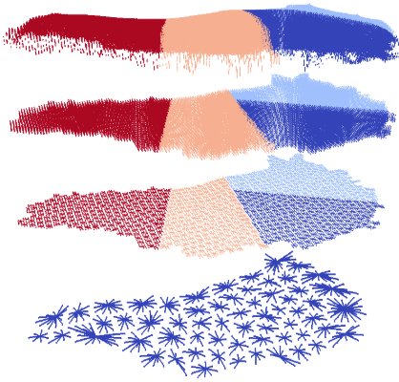
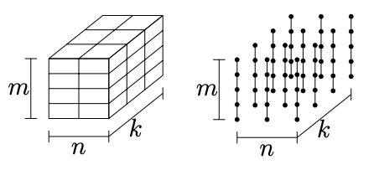
Problem Motivation
What are block tridiagonal problems?
1D partial differential equation discretization: [-1 2 -1] / h² Multiphysics variant is block tridiagonal
Extruded meshes with multigrid semi-coarsening
Block structured meshes with dominant direction Body fitted mesh for instance
Block Structured mesh with dominant vertical lines
Greenland mesh hierarchy for multigrid - top two levels have vertical lines - bottom two levels are effectively 2D

Slide 21
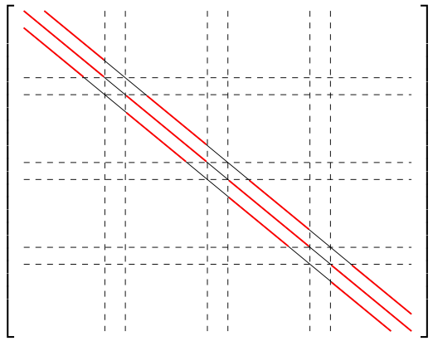
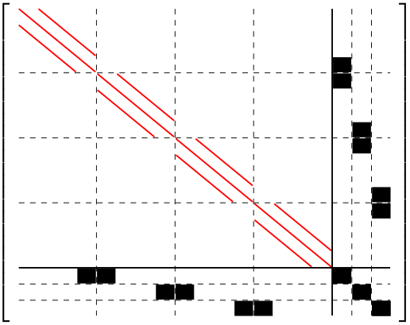
Block tridiagonal solver
General Idea
Lines are decoupled → good for parallelization
Dense blocks → good for algorithmic intensity and vectorization
On GPU further acceleration is possible
Sublines / Schur complement approach
Subdivide each line
Solve for each subline independently
Solve a Schur complement for connections between sublines
Prefix sum
Pre-compute diagonal blocks factorization
Solve using a parallel prefix sum

Slide 22
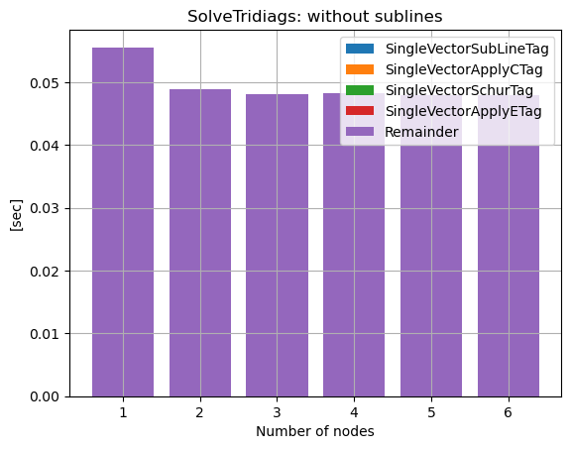
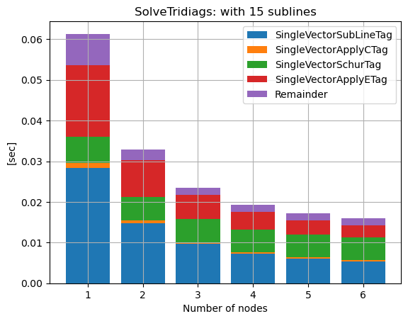
BTDS on GPUs
Distributed solver in Trilinos/Ifpack2
Batched algorithms in Kokkos Kernels
Portable algorithms tested on
CPU: Intel, AMD, ARM
GPU: NVIDIA, AMD, Intel
Above: comparison of BTDS on two GPU architectures, MI250x (Frontier GPU) and Ponte Vecchio (Sunspot GPU)
Block Tridiagonal Solver on Frontier (MI250x GPUs), left: parallelized over lines, right: parallelized over lines and sublines. Later approach increases strong scaling performance significantly.

Slide 23
Stream ILU(K)/SPTRSV
Vinh Dang

Slide 24
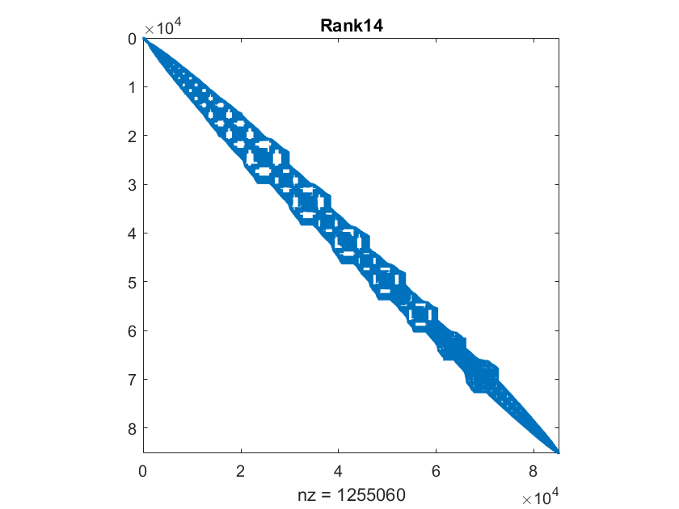
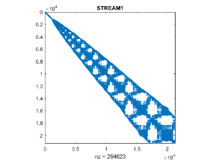
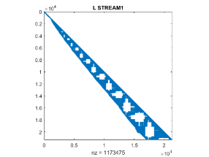
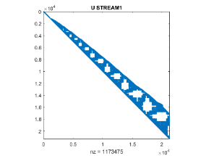
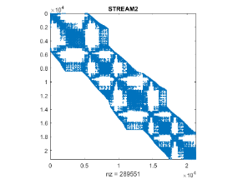
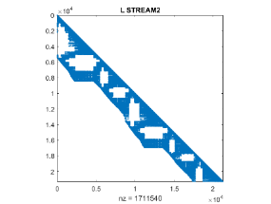
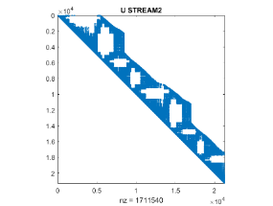
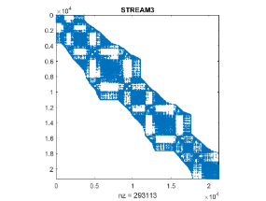
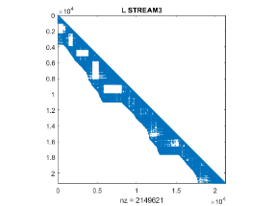
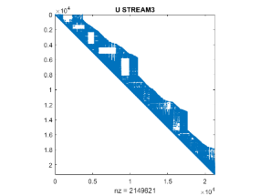
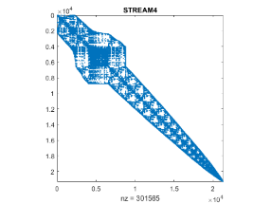
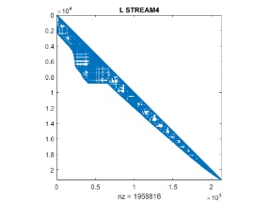
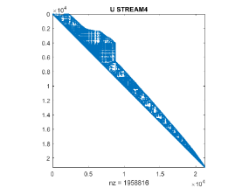
Use case: ILU(k)-preconditioned iterative solve
Stream SpILUK/SpTRSV integrated into Ifpack2’s RILUK and local triangular solver in Trilinos
Decompose the problem as we would to MPI processes
Divide each MPI domain to sub-domains (each sub-domain is assigned to a stream)
Use stream SpILUK and SpTRSV per sub-domain
Local MPI rank matrix
Stream-split matrices
Stream-split factors
L
U

Slide 25
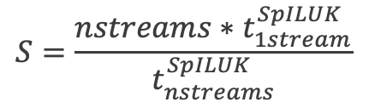
Performance of Stream SpILU(k=3)
Scaling study: 1 to 16 streams
Good speedup as compared to a single stream
Good scaling overall up to 8 streams
Some scalability loss in SpILUK on 16 streams, e.g. boneS01, m_t1
$$S=\frac{nstreams∗t_{1stream}^{SpILUK}}{t_{nstreams}^{SpILUK}}$$

Slide 26
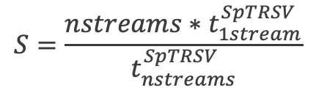
Performance of stream SpTRSV
Scaling study: 1 to 16 streams
Good speedup as compared to a single stream
Good scaling overall up to 8 streams
Some scalability loss in SpTRSV on 16 streams, e.g. boneS01
For the best performance on each stream, KK SPTRSV calls the NVIDIA’s cuSPARSE triangular solve APIs (results obtained with CUDA 11.7)
$$S=\frac{nstreams∗t_{1stream}^{SpTRSV}}{t_{nstreams}^{SpTRSV}}$$

Slide 27
ODE Time integrators
Luc Berger-Vergiat

Slide 28
On device time integrators
Typical use cases
Embedded integrator within special discretization
Within UQ framework for reliability assessment
Inside automated discovery framework (optimization, AI, etc…)
Requirements
Integrators callable within device call
Good utilization of bandwidth available
Portability across vendors

Slide 29
Integrators families
Explicit time integrators
Runge-Kutta families
Order 1 to 5 available
Initial time step estimation
Time step adaptation
Implicit time integrators
Backward difference formulae
Order 1 to 5 available
Order and Time step adaptation
Convergence of time integrators on damped unforced harmonic oscillator. Both explicit (top) and implicit (bottom) integrators achieve theoretical rate of convergence. No time or order adaptation was used.

Slide 30
Integrators performance
Explicit Integrator
RK Cash-Karp
Adaptive stepping
Simple reactant/product reaction
Implicit Integrator
BDF
Adaptive order and stepping
Robertson autocatalytic reaction (very stiff start)
Preliminary results: 1.5x speed-up on 10,000 problems
 | 10,000 | 100,000 | 1,000,000
Intel Broadwell | 3.17128 | 31.709 | 408.545
NVIDIA V100 | 0.0303719 | 0.365714 | 2.33355
Speed-up | 11.601 | 9.634 | 19.45

Slide 31
New Ecosystem Efforts

Slide 32
KokkosFFT
POC: Yuuichi Asahi (yuuichi.asahi@cea.fr)
New effort to provide fast fourier transform calls
Wraps existing libraries such as FFTW, cuFFT, rocFFT and MKL
Local calls only – no global (MPI supported) FFT
Generally inspired by numpy.fft interface
Takes Kokkos::View as arguments and integrates with Execution space instances
FFT Plans are only internal objects for now
Standard FFT functions: fft, ifft, fft2, ifft2, fftn, ifftn
Real FFT functions: rfft, irfft, rfft2, rfftn, irfftn
Hermitian FFT functions: hfft, ihfft
https://github.com/kokkos/kokkos-fft

Slide 33
Simple Usage Example
Kokkos::View<double*> x("x", n);
Kokkos::View<Kokkos::complex<double>* > x_hat("x_hat", n/2+1);
Kokkos::Random_XorShift64_Pool<> random_pool(12345);
Kokkos::fill_random(x, random_pool, 1);
Kokkos::fence();
Kokkos::DefaultExecutionSpace exec;
KokkosFFT::rfft(exec, x, x_hat);
exec.fence();

Slide 34
KokkosComm – MPI Interfaces for Kokkos::View
New effort to provide more convenient MPI Interface
User avoids extracting raw pointers and lengths from Kokkos::View
Develop common facilities to deal with non-contiguous Views
Interface very close to MPI in spirit – but replaces pointers/lengths with View
But early stages: expect tweaks to API based on feedback!
Join #mpi-interop on slack
MPI | KokkosComm
MPI_Send | send / send<CommMode::Standard>
MPI_Rsend | send<CommMode::Ready>
MPI_Recv | recv
MPI_Ssend | send<CommMod::Synchronous>
MPI_Isend | isend / isend<CommMode::Standard>
MPI_Irsend | isend<CommMode::Ready>
MPI_Issend | isend<CommMode::Synchronous>
MPI_Reduce | reduce
https://github.com/kokkos/kokkos-comm

Slide 35
Simple Usage Example
// Assume just two MPI ranks
int rank; // 0 or 1
MPI_Comm_rank(MPI_COMM_WORLD, &rank);
// Get default execution space
auto exec_space = Kokkos::DefaultExecutionSpace();
// Compute something for a View<T*> send_view
Kokkos::parallel_for(RangePolicy(exec_space, 0, N), functor1(send_view));
// Send data asynchronously
auto req = KokkosComm::isend(exec_space, send_view, (rank+1)%2, 0 /*tag*/ , MPI_COMM_WORLD);
// Recv data synchrounously
KokkosComm::recv(exec_space, recv_view, (rank+1)%2, 0 /*tag*/, MPI_COMM_WORLD);
// Could start computing on recv_view now
Kokkos::parallel_for(RangePolicy(exec_space, 0, N), functor2(recv_view));
// Wait for send operation to finish
req.wait();

